Slide 1


Starting Your Homelab
SciaticNerd.com
@SciaticNerd

Slide 2

Disclaimer: There are other and likely better ways to do all this. This is just what’s working so far

Slide 3
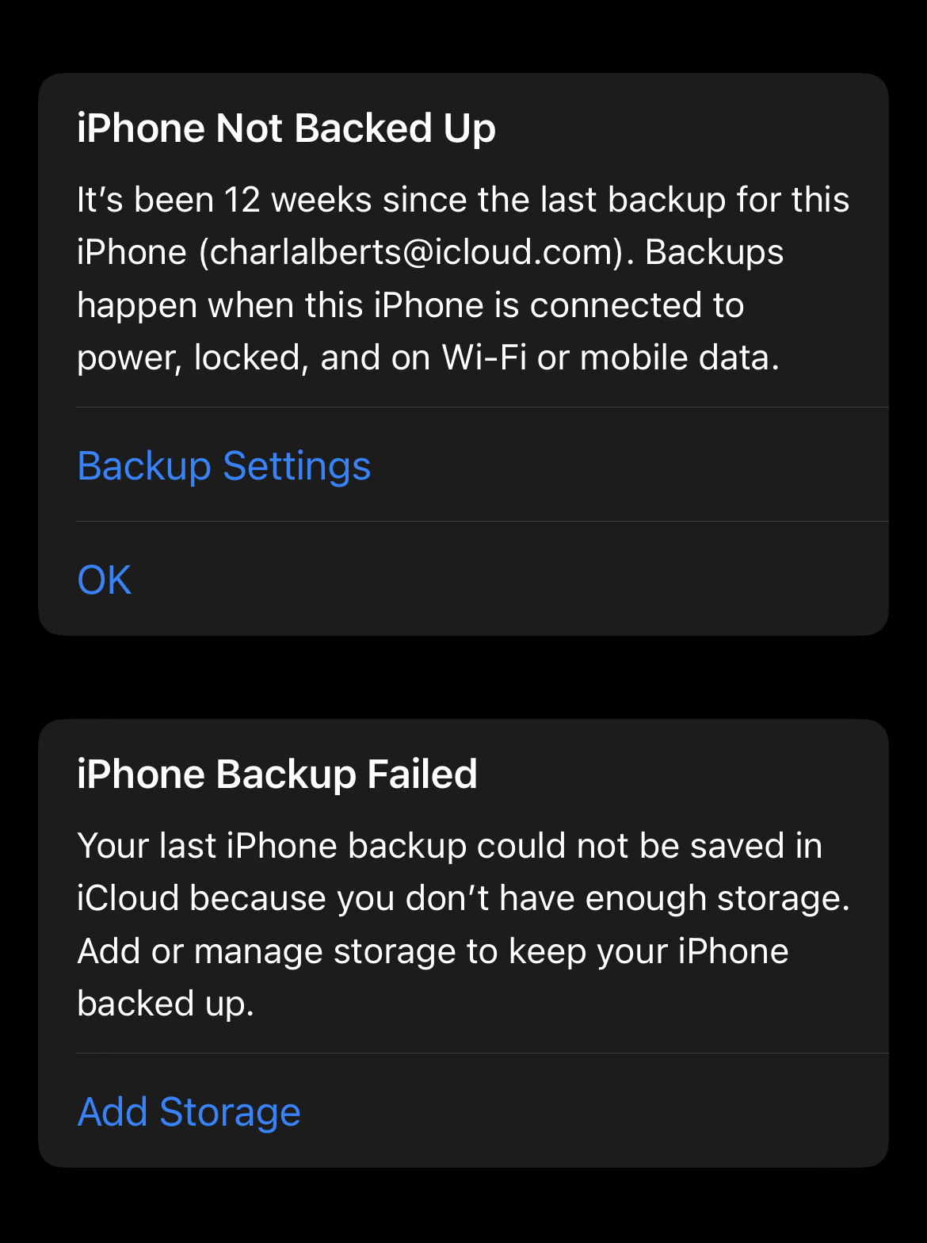
Always Out Of Space?
Are we though?

Slide 4
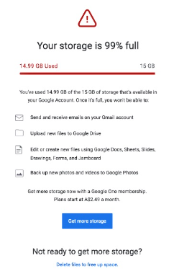
Doesn’t matter which BigCo we talk about

Slide 5
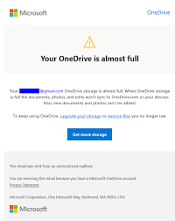
They all seem to sing the same tune

Slide 6
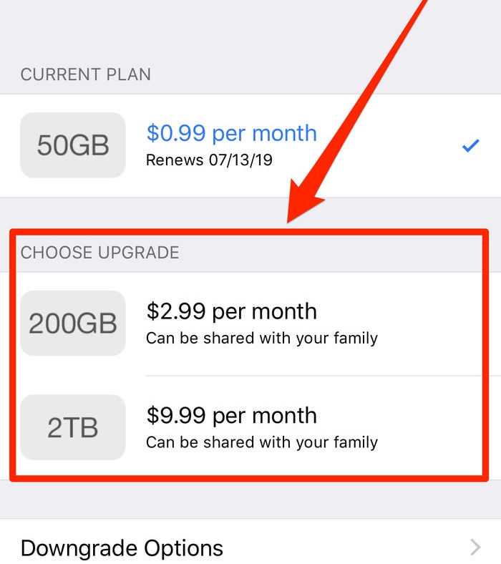
The Real Reason
Just a way to get more invested

Slide 7
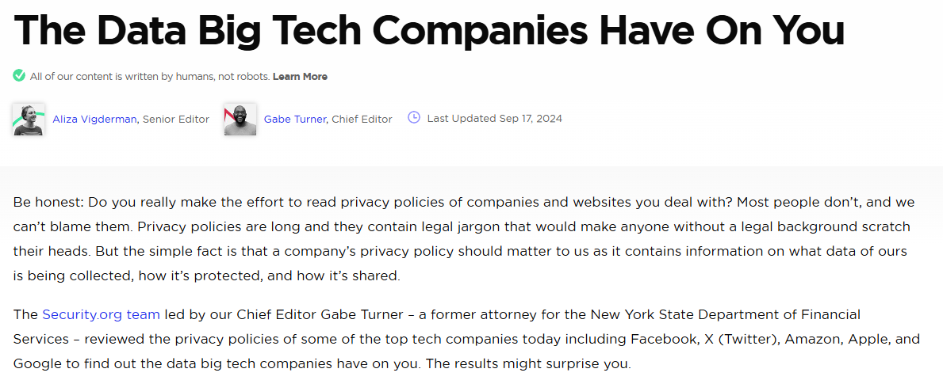
You Know the rule
“IF YOU AREN’T PAYING FOR A PRODUCT, YOU ARE THE PRODUCT.”
https://www.security.org/resources/data-tech-companies-have/

Slide 8
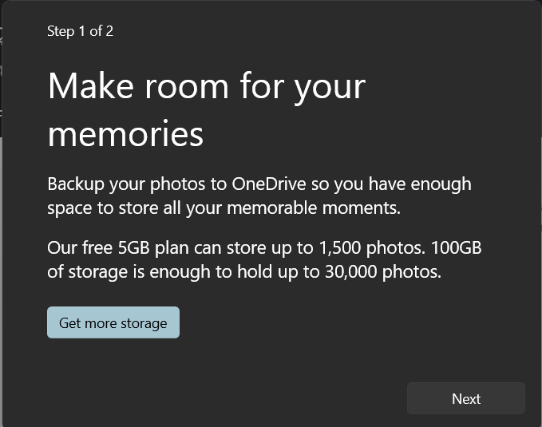
THIS is what I’m talking about

Slide 9
Self-Hosting Considerations
Cost of Options
Use Cases
Considerations and Risks
Stages: Building Things Out

Slide 10
Use Cases
Photo management
Document management
Planning
Organizing
Note taking
Media stuff
Event Management

Slide 11
Get A Free Password Manager Account
Bitwarden
Dashlane
LastPass
NordPass
Proton Pass
RoboForm
KeePass

Slide 12
Things to Consider
Cost of Options
Use Cases
Risks
Stages: Building Things Out

Slide 13
Stages of the Build
Machine
Drive
Network
VPN
Virtualization
Platform

Slide 14
Stages: Building Things Out
Establish Email
Make boot media
Install / Updates
VPN Connection
Domain Stuff
Setup Platform
Email: Create an ID to work from
Media: Pi Imager tool and external media
Secure the connection / split DNS
Free domain vs Paid and DNS
Wildcard Let’s Encrypt Certificate
ComsosCloud vs. CasaOS

Slide 15

Recommended Accounts
For this demo
Password Manager
New Email
Email >> Tailscale
GitHub >> DuckDNS
GitHub >> LetsEncrypt

Slide 16
Accounts for Tailscale Login
A NEW Email Address to use as an Identity Provider
Apple
Google
Microsoft
Okta
OneLogin
OIDC

Slide 17
Stages: Accounts for other Accounts
E-Mail
Tailscale
GitHub
GitHub
Tailscale
DuckDNS
DuckDNS
CloudFlare
Let’sEncrypt

Slide 18
Stages: Establishing Trust and AuthN
Identity
Email
Domain
DuckDNS
Private
Wiregard: Tailscale
Secured
AuthN
Domain Validation
Wildcard LE Certificate
Subdomains
Reverse Proxy

Slide 19
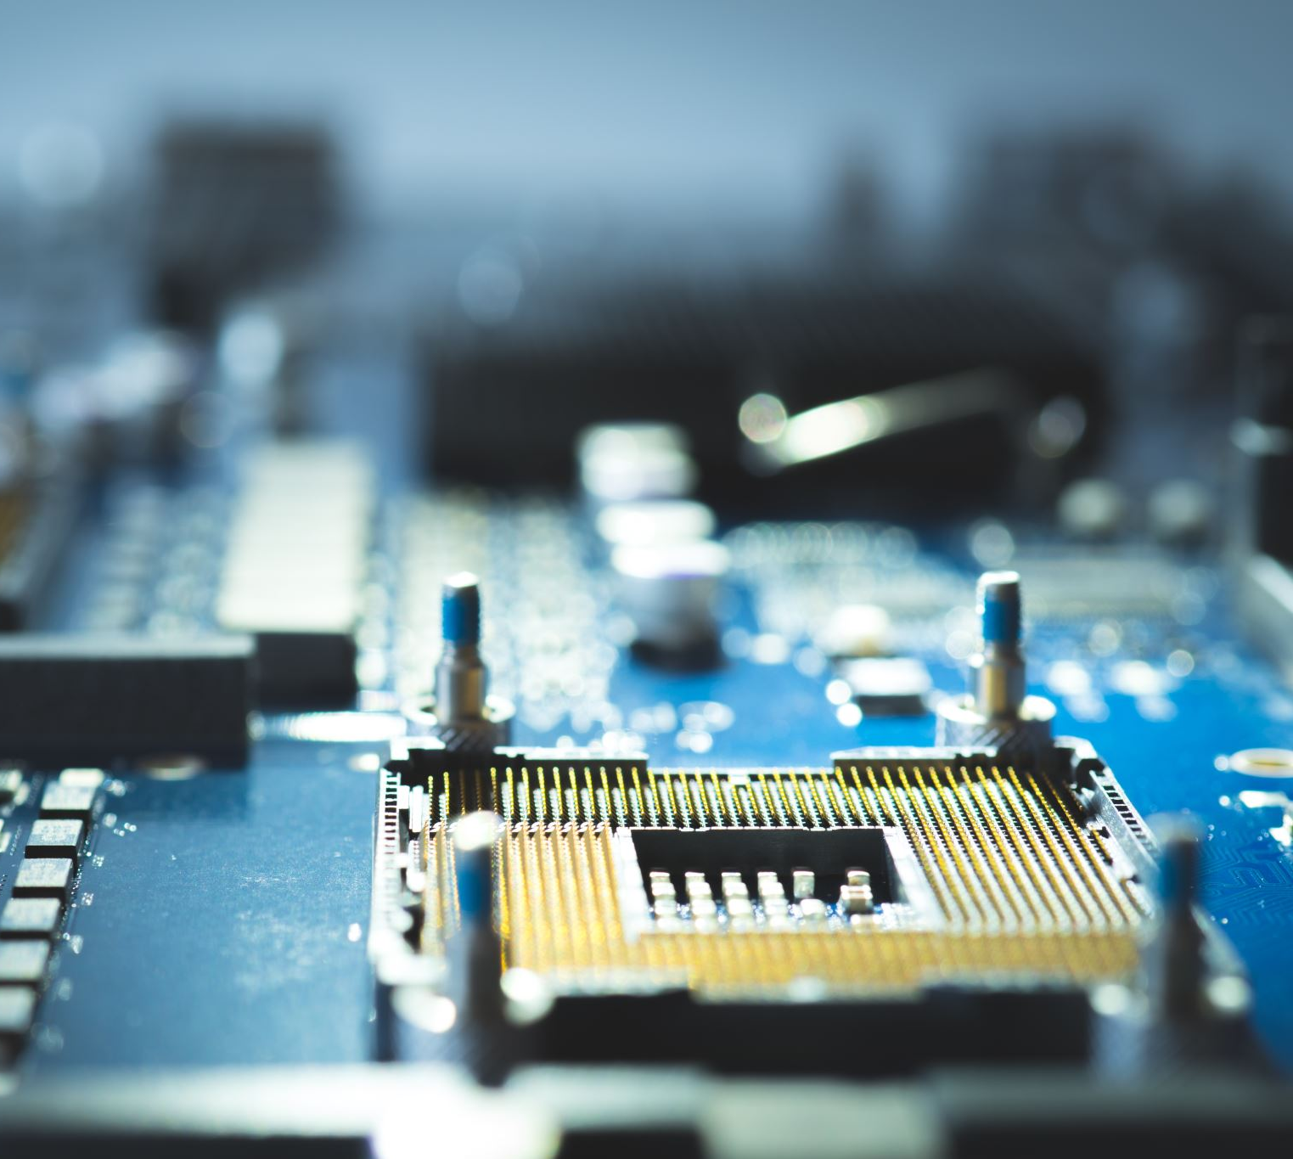
Stages:
Your Build
Pi3 + powered external drive
Pi4 + NVME
Old PC
Cloud VPS

Slide 20
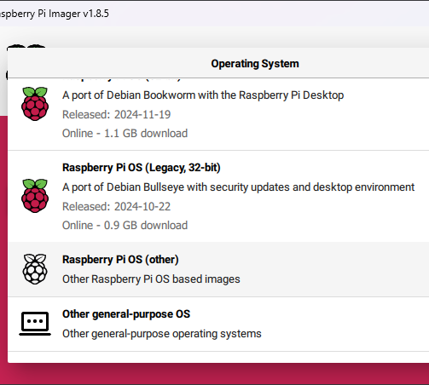
Stages: Pi Prep
Choose your type of Pi
Select Choose OS
Raspberry Pi OS (Other)

Slide 21
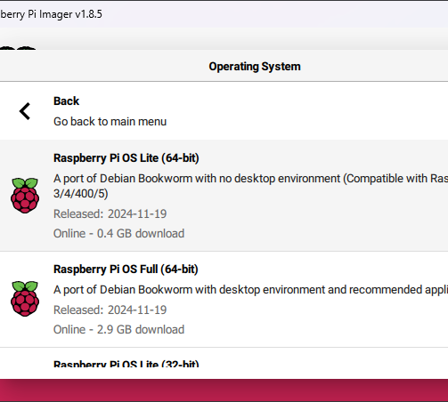
Stages: Pi Prep Cont’d
Select Raspberry Pi OS Lite (64-bit)
Goal: Headless
Choose your storage
  Powered HDD
  NVME in a case
Select Next

Slide 22
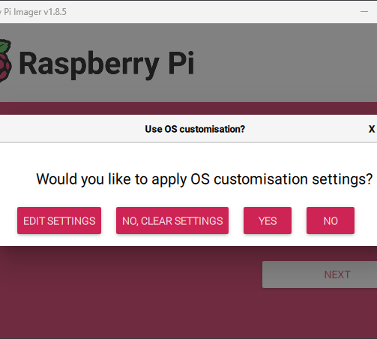

Stages: More Pi Prep
After clicking Next
Click Edit to prep settings

Slide 23
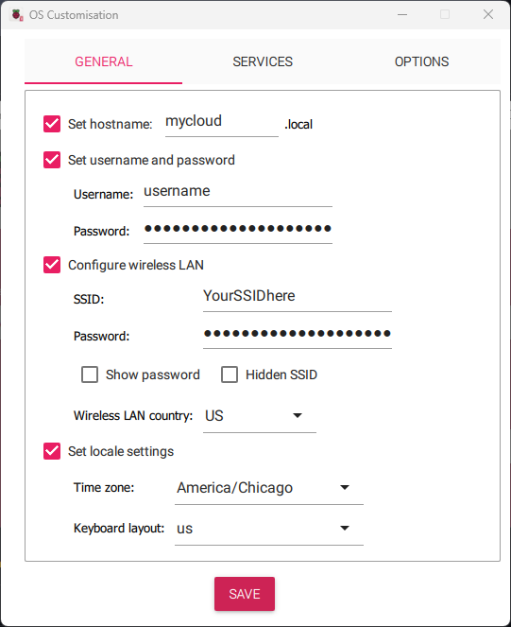
Stages: More Pi Prep
Set your desired hostname
Login details
Wi-Fi Details, Country, Timezone
Make sure SSH is set up on the Services tab
Click Save
Now click YES to write the changes to media

Slide 24
Stages: More Pi Prep
https://support.google.com/mail/answer/56256?hl=en
Set your desired hostname
Login details
Wi-Fi Details, Country, Timezone
Make sure SSH is set up on the Services tab
Click Save
Now click YES to write the changes to media

Slide 25
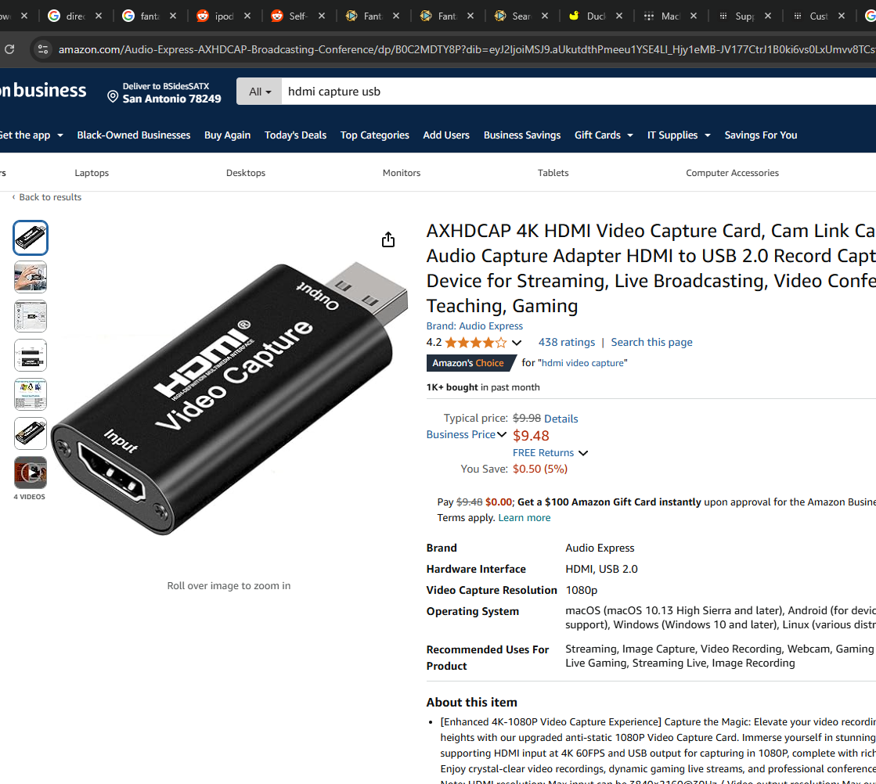
Extra Display Tip
Need a spare monitor?
HDMI capture device
Use camera app
  Windows: Camera
  Mac: PhotoBooth
  OBS: Video Capture device

Slide 26
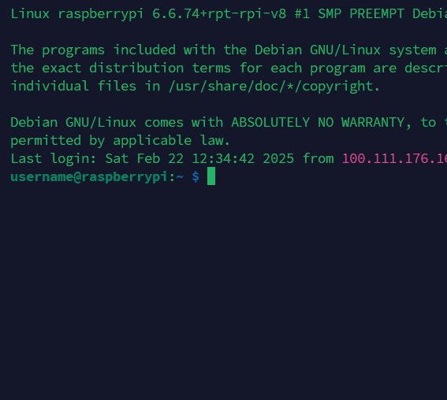
Extra Display Tip
See machine’s display
Requires separate keyboard
Easier if you can SSH
Allows correction if remote not working

Slide 27
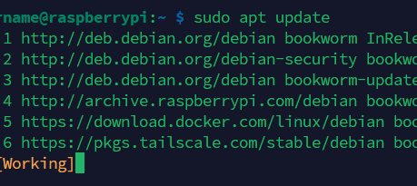
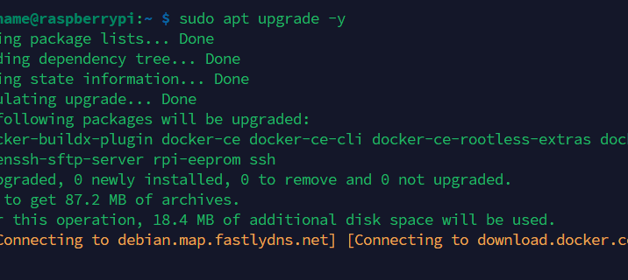
Standard first Debian Steps
$ sudo apt update
Same either direct or over SSH
Now we get to the waiting
What if you can’t get connected??
Networking issues can be a thing
$ sudo apt upgrade -y

Slide 28
Manual Network config: broken out
$ sudo nmcli connection
$ sudo nmcli connection modify
Ipv4.method
Ipv4.address
Ipv4.gateway
Ipv4.dns
Use the name shown in the list
“Wired Connection 1”
Manual (Choose an address outside DHCP range)
192.168.1.10/24 or similar
192.168.1.1 or what your home router says
8.8.8.8 or 1.1.1.1 or your own if you have one

Slide 29
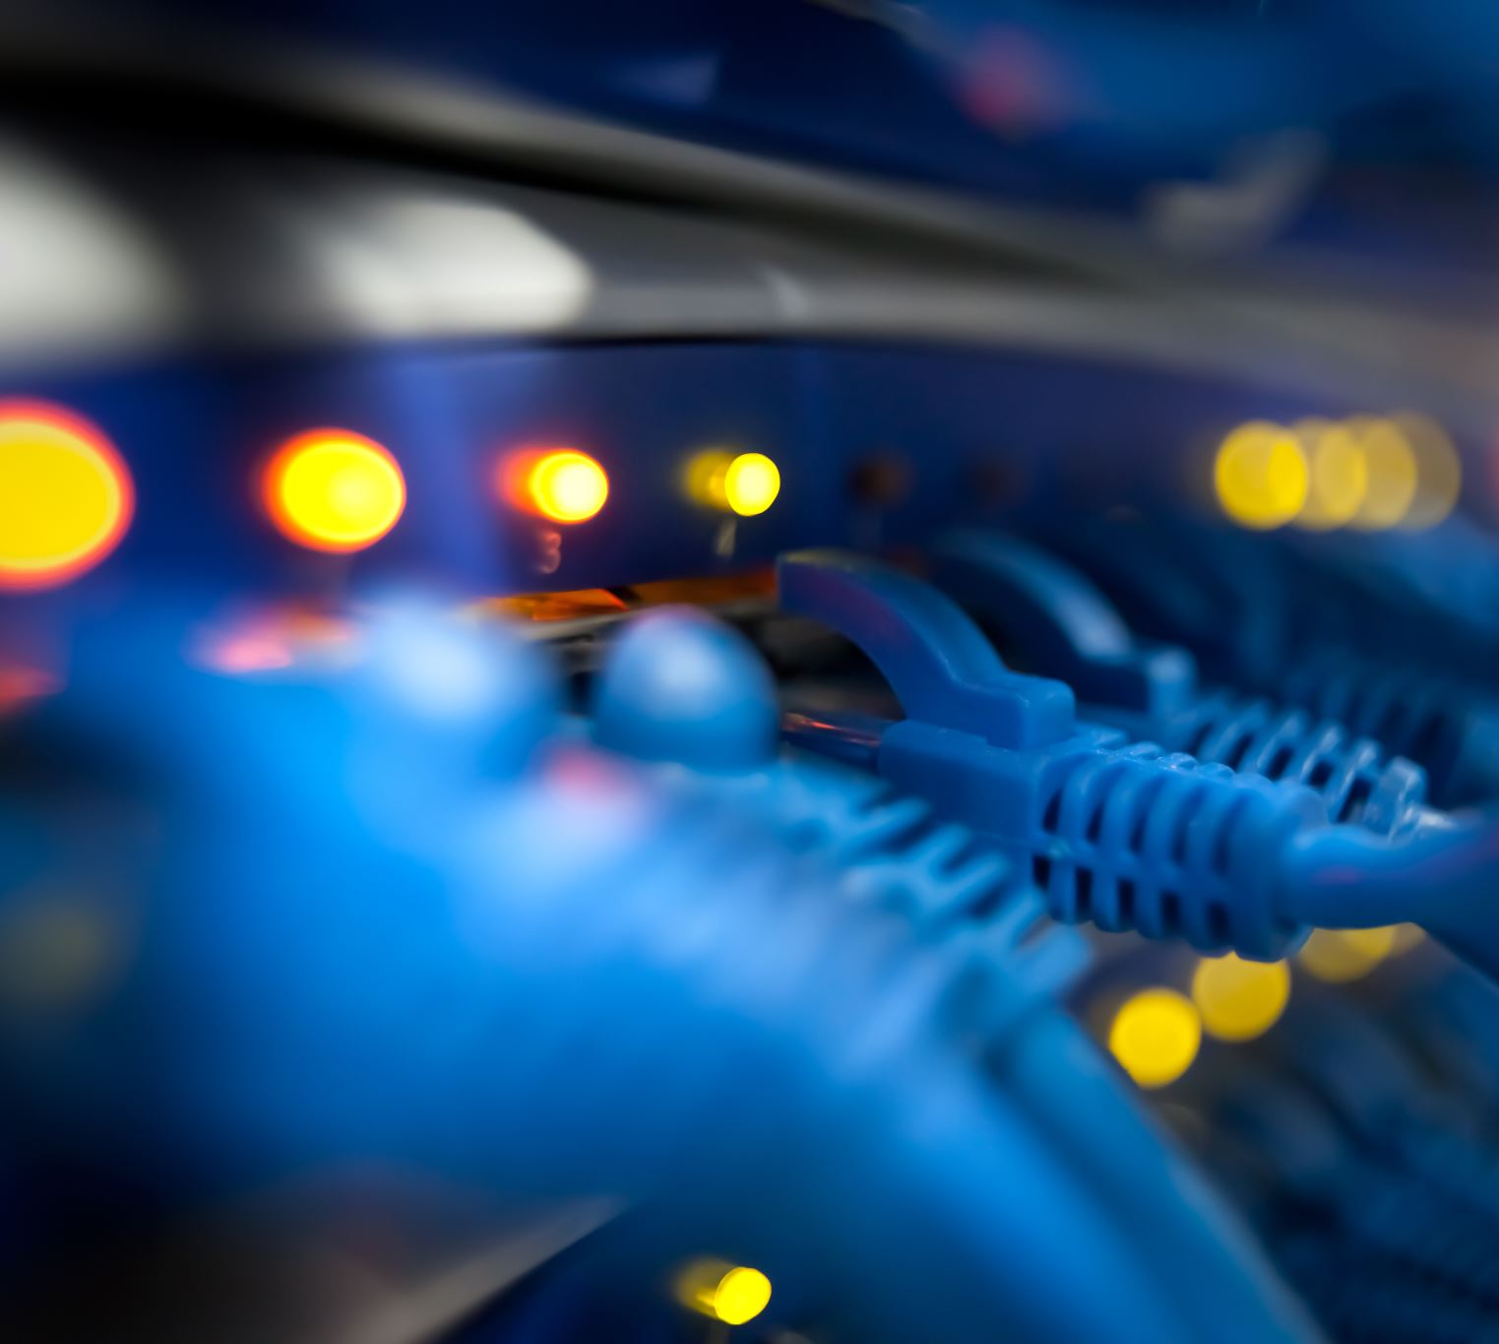
What is Tailscale?
Tailscale is a virtual private network (VPN) that lets you securely connect devices and services across networks. It uses the open-source WireGuard protocol to create encrypted connections

Slide 30
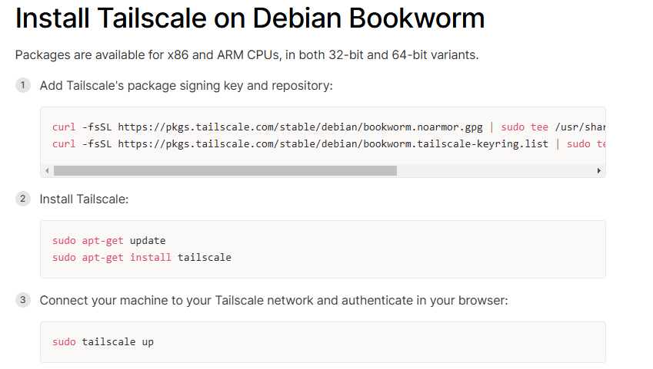
Tailscale Installation https://tailscale.com/kb/1174/install-debian-bookworm

Slide 31
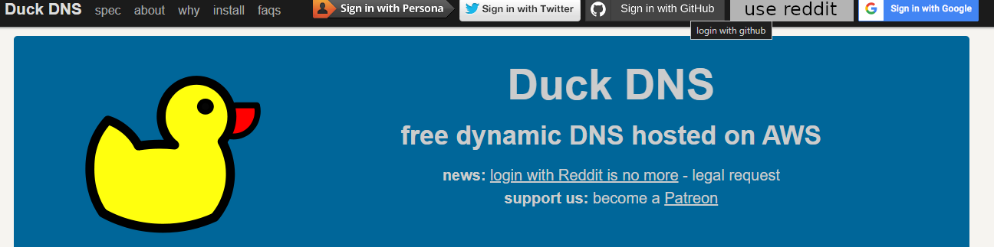

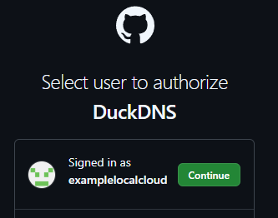
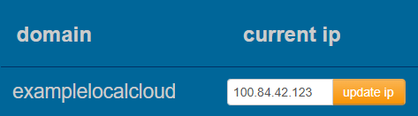
Get a Domain: DuckDNS.org
DuckDNS is a free service that lets you associate a domain name with your dynamic IP address. This allows you to access your home network from anywhere using a custom domain name.

Slide 32
Get a Domain: DuckDNS.org

Slide 33
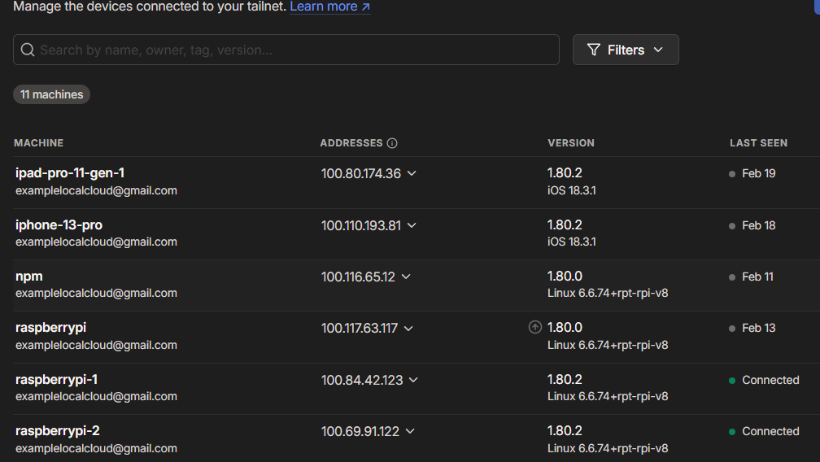
Tailscale Admin Page

Slide 34
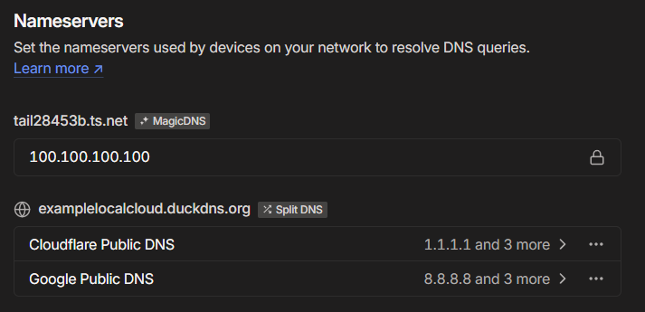
Tailscale: Setting Split DNS
https://tailscale.com/learn/why-split-dns#do-i-need-split-dns
Do I need split DNS?
It depends. Sometimes split DNS is used because it allows you to update the DNS records for internal-facing services faster than if you used the DNS servers for the public internet.

Slide 35
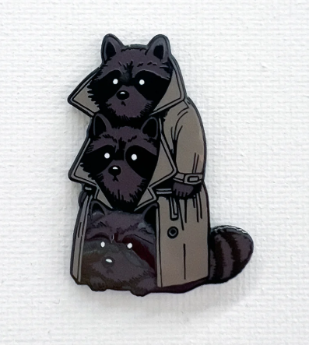
What is Docker?
Containers – gerrymandered computing resources
Like VMs – They persist bit of computing
They can be networked together
They’re risky and need persistent storage
IT MAKES THIS WORK, THAT WHAT IT IS

Slide 36
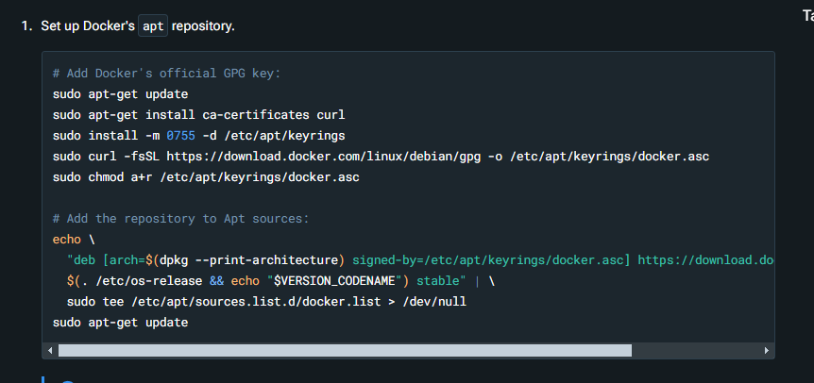
Install Docker
https://docs.docker.com/engine/install/debian/
Set up Docker’s APT Repository
Install the latest version
Prove things work Hello World!
Now, you’re even MOAR dangerous
It’s time for your platform!

Slide 37

CosmosCloud or CasaOS?
Choose your platform
(There really are tons more options, but this is where I’ve found wins lately)

Slide 38
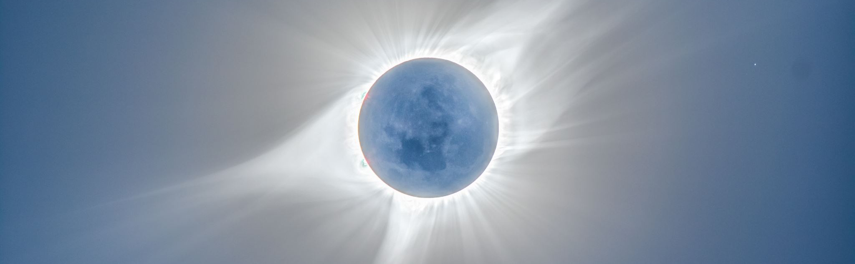
Installing CosmosCloud
curl -fsSL https://cosmos-cloud.io/get.sh | sudo -E bash -s

Slide 39
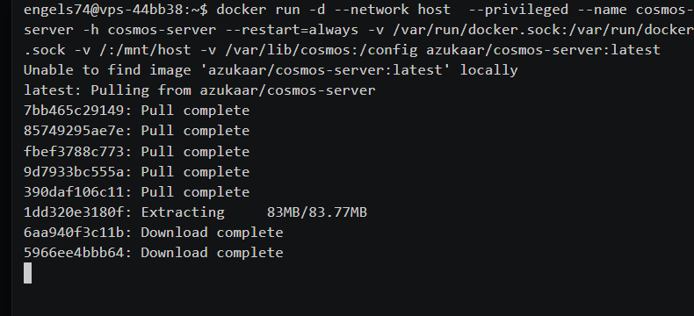
What the install looks like
Exciting, right?
Alternate guide to consider
https://guides.engels.zip/

Slide 40
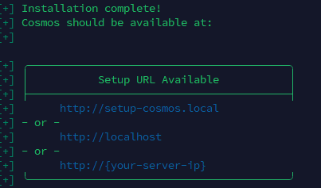
Once installed
Time to configure things

Slide 41
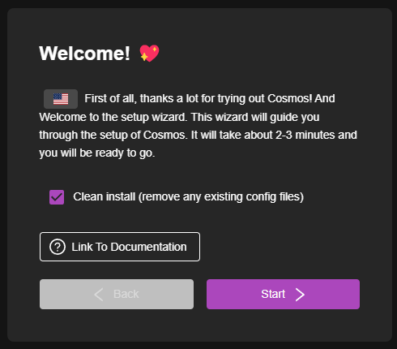
Set up Cosmos
Connect to the Tailscale IP
Check the Clean Install option
Click Next

Slide 42
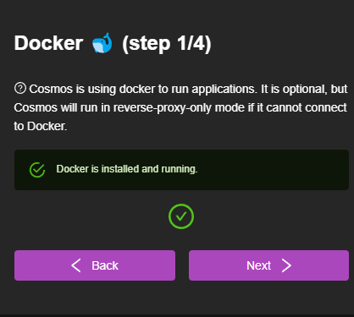
Cosmos: Docker

Slide 43
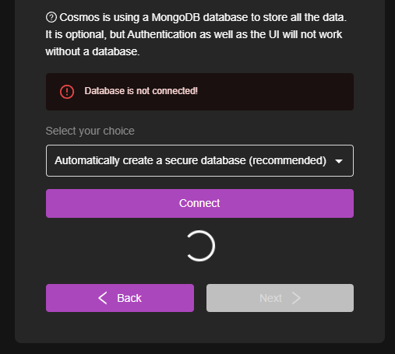
Cosmos: Database

Slide 44
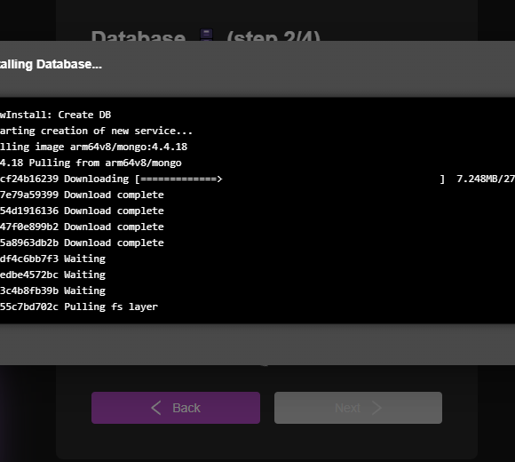
Cosmos: Database build

Slide 45
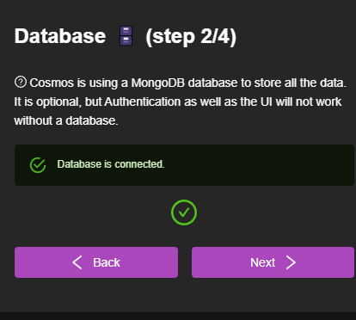
Cosmos Database Connected

Slide 46
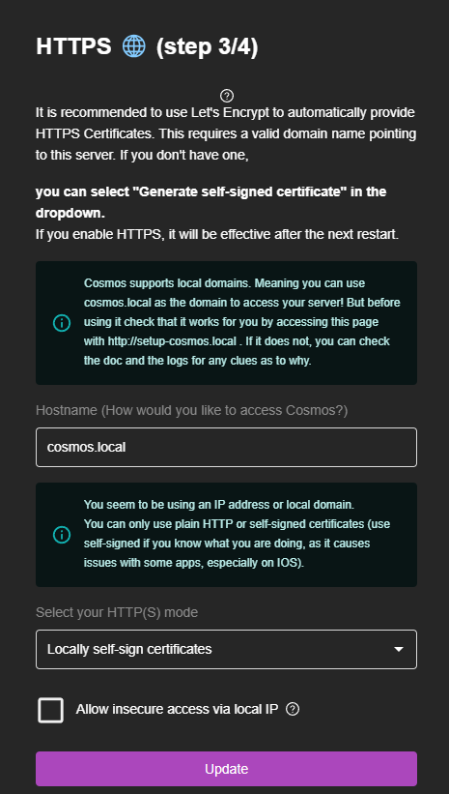
Cosmos: HTTPS

Slide 47

Remember DuckDNS?

Slide 48


Create a new Domain entry
Tailscale IP address of the machine running Cosmos

Slide 49
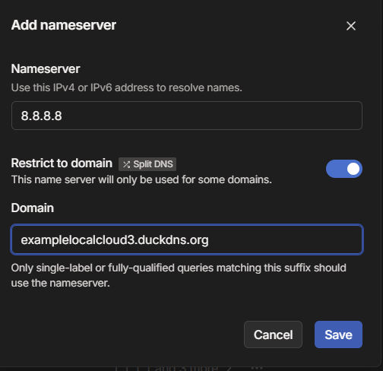
Add SplitDNS entries in Tailscale

Slide 50
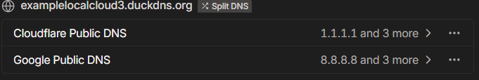
Tailscale: New SplitDNS Entries
Remember: This is to help the Internet’s Phonebook (DNS) see our new name more quickly. Why? So we don’t have to wait as long to get a certificate!
Why do we want a TLS Certificate for our home server if we’re connected over a Private Network connection secured with Wiregard??
Why Even MOAR Security! Encrypted connection, secure handshakes, Unlimited Figgy Pudding. Lots of reasons.

Slide 51
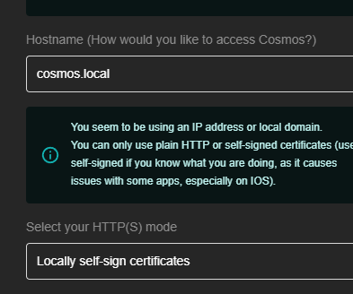
Back to the Cosmos Setup: HTTPS
We’re going to update things with the domain name we just established

Slide 52
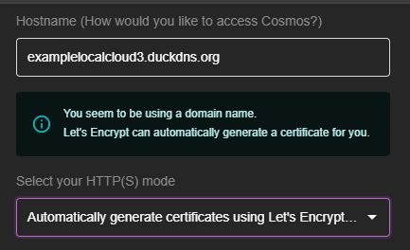
Cosmos HTTPS: Let’s Encrypt Part 1
Put the domain we just created in DuckDNS into the Hostname box
Change the HTTPS mode to Automatically Generate using Let’s Encrypt
Time to configure how we get the cert!

Slide 53
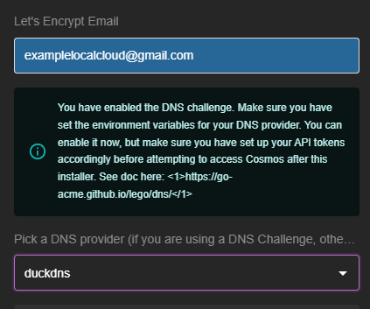
Cosmos HTTPS: Let’s Encrypt Part 2
Put the Email address from earlier in the Let’s Encrypt Email blank
Select DuckDNS from the DNS Provider dropdown
The email address will be used to help prove your ownership of the domain
Next is granting Let’s Encrypt access to DuckDNS to perform it’s Challenge to prove we own the domain

Slide 54
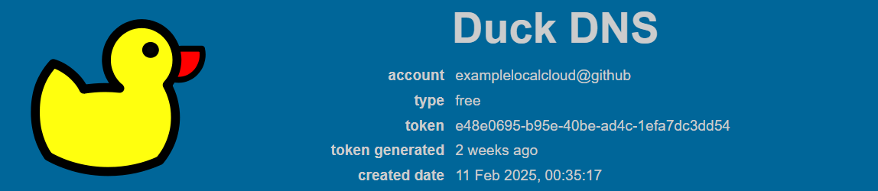
Cosmos HTTPS: Let’s Encrypt Part 3
YourEmailHere
Copy the token and paste into Cosmos
Make sure you’re logged into DuckDNS, because it logs out after a while
Copy the string to the right of Token
This is your account’s custom token that will allow Cosmos to talk to the Let’s Encrypt system
Let’s Encrypt needs to prove we own the domain so it trusts us enough to issue signed certificates to our server.

Slide 55

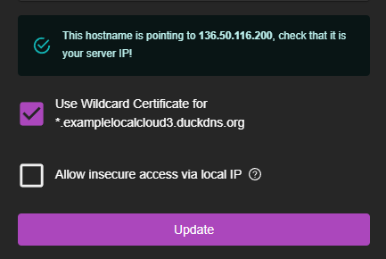
Cosmos HTTPS: Let’s Encrypt Part 4
Paste your DuckDNS token here
Expand the DNS Challenge Setup section on the Cosmos HTTPS setup page
Scroll down to the DuckDNS_Token blank and paste in the token
Check the Wildcard cert box
NOW LEARN THE FOLLY OF DNS
If the IP Address next to the checkmark is NOT your Tailscale IP address: WAIT

Slide 56
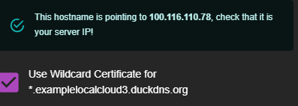
Cosmos HTTPS: Let’s Encrypt Day 98763.2

Slide 57
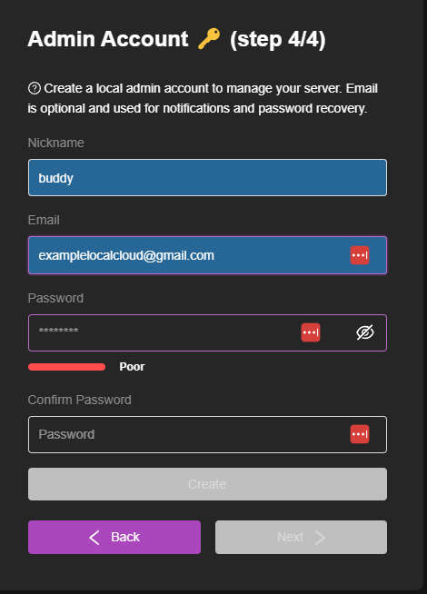
Cosmos Admin Account

Slide 58
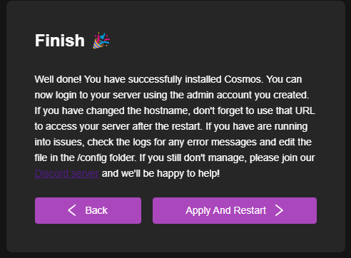
Cosmos Setup: Apply and Restart

Slide 59
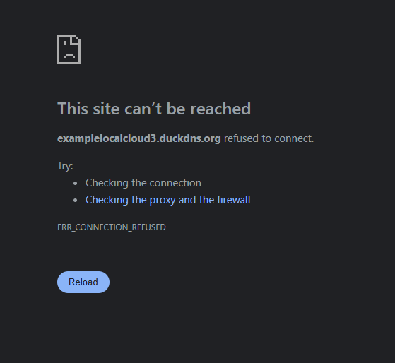
Don’t Be Surprised

Slide 60
Be Patient
Lots of variables
System specs
Drive Speed
Blood sacrifice
Jobu?

Slide 61

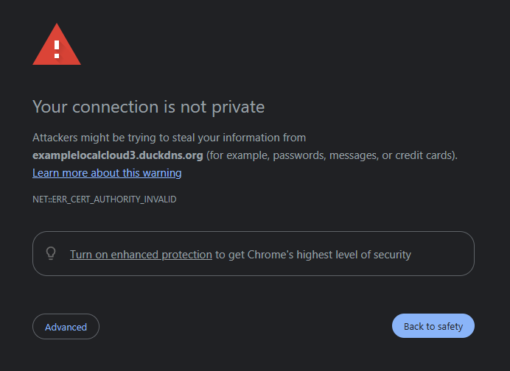
Now try again

Slide 62
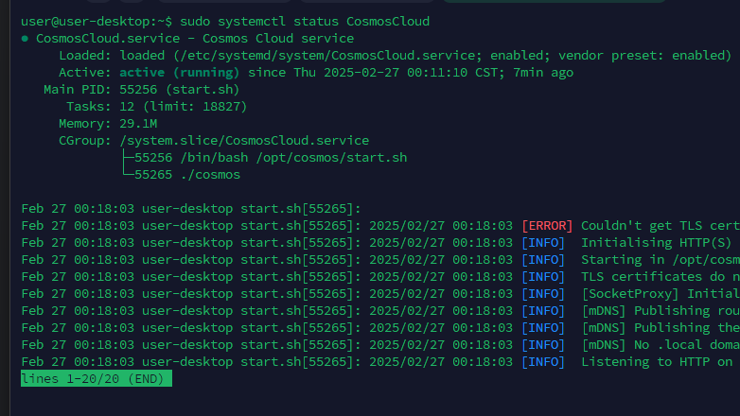
Try http, then the IP address
$ sudo systemctl status CosmosCloud
If listening on port 80 – Might not have gotten the cert.
Restart the service – it will try again
$ sudo systemctl restart CosmosCloud

Slide 63
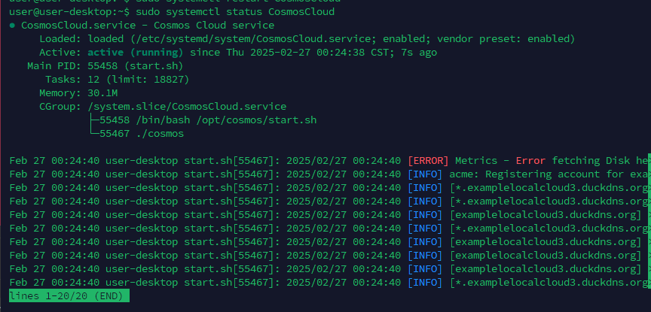
This is why you restart: DNS is Evil

Slide 64
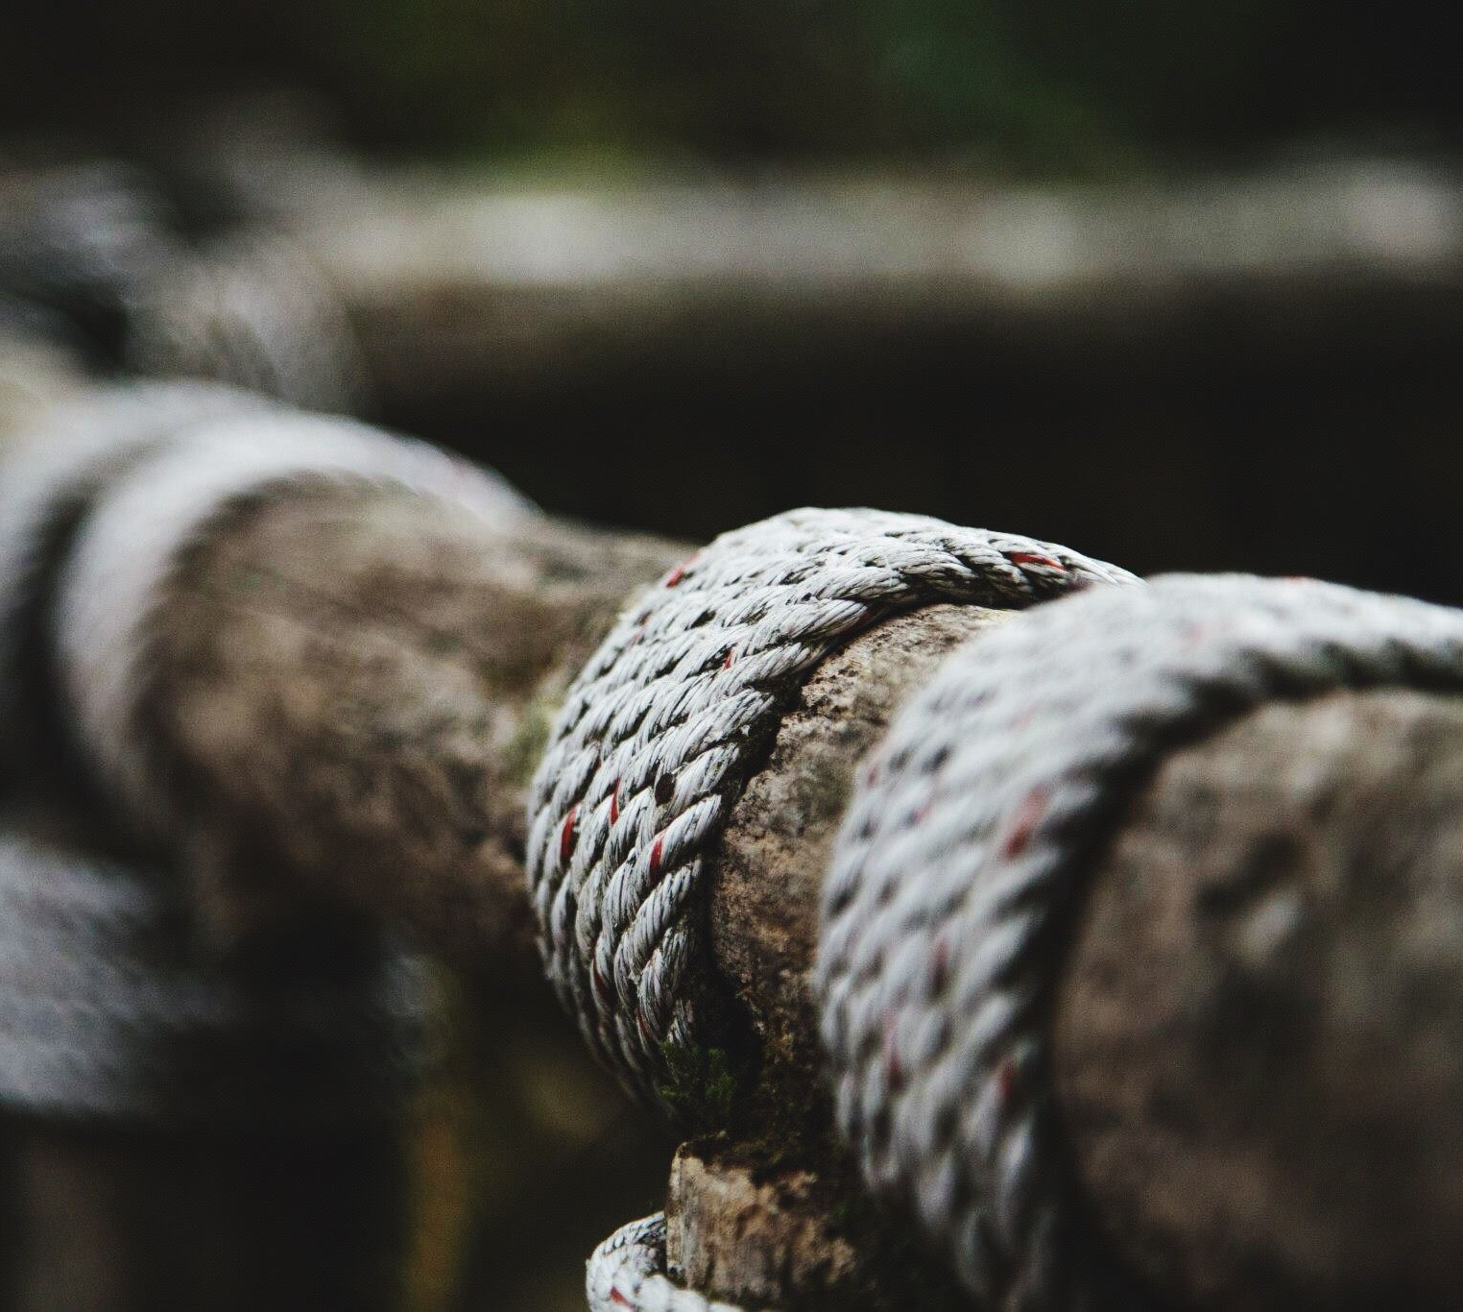
DON’T YOU DARE GIVE UP
That’s just what it wants.
You can do this!
Show it no fear
Just the other side of that horizon… is another horizon

Slide 65

If a kid who used to think this duck was scary can pull this off, you can too!

Slide 66
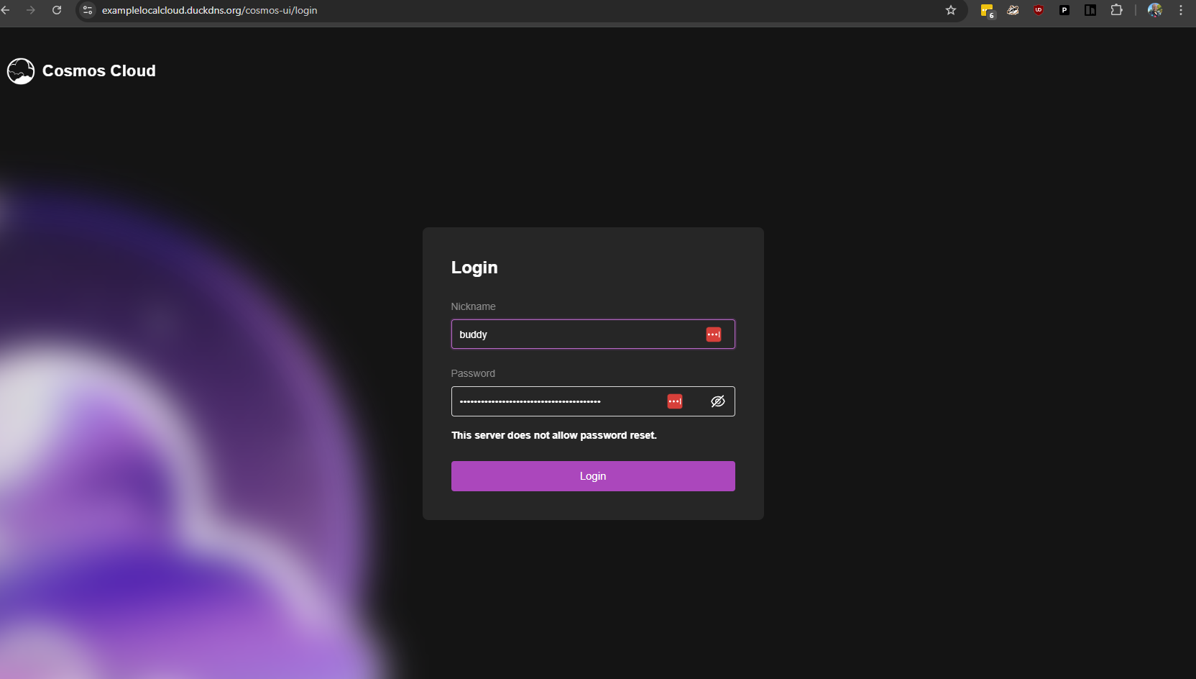
Your reward for perseverance

Slide 67
Say it with me:
IT WAS DNS

Slide 68
Now What? Go get some amazing applications!
Cosmos Resources
  https://github.com/azukaar/awesome-cosmos-cloud
  https://cosmos-cloud.io/doc/1%20index/#install-cosmos-as-a-docker-container
  https://guides.engels.zip/
Self-Hosted App Resources
  https://github.com/awesome-selfhosted/awesome-selfhosted
  https://github.com/1Crazymoney/awesome-selfhosted-saas
  https://selfh.st/apps/
  https://www.composerize.com/ - Format any docker command into a compose and back again

Slide 69

SciaticNerd.com
@SciaticNerd

